Slide 1
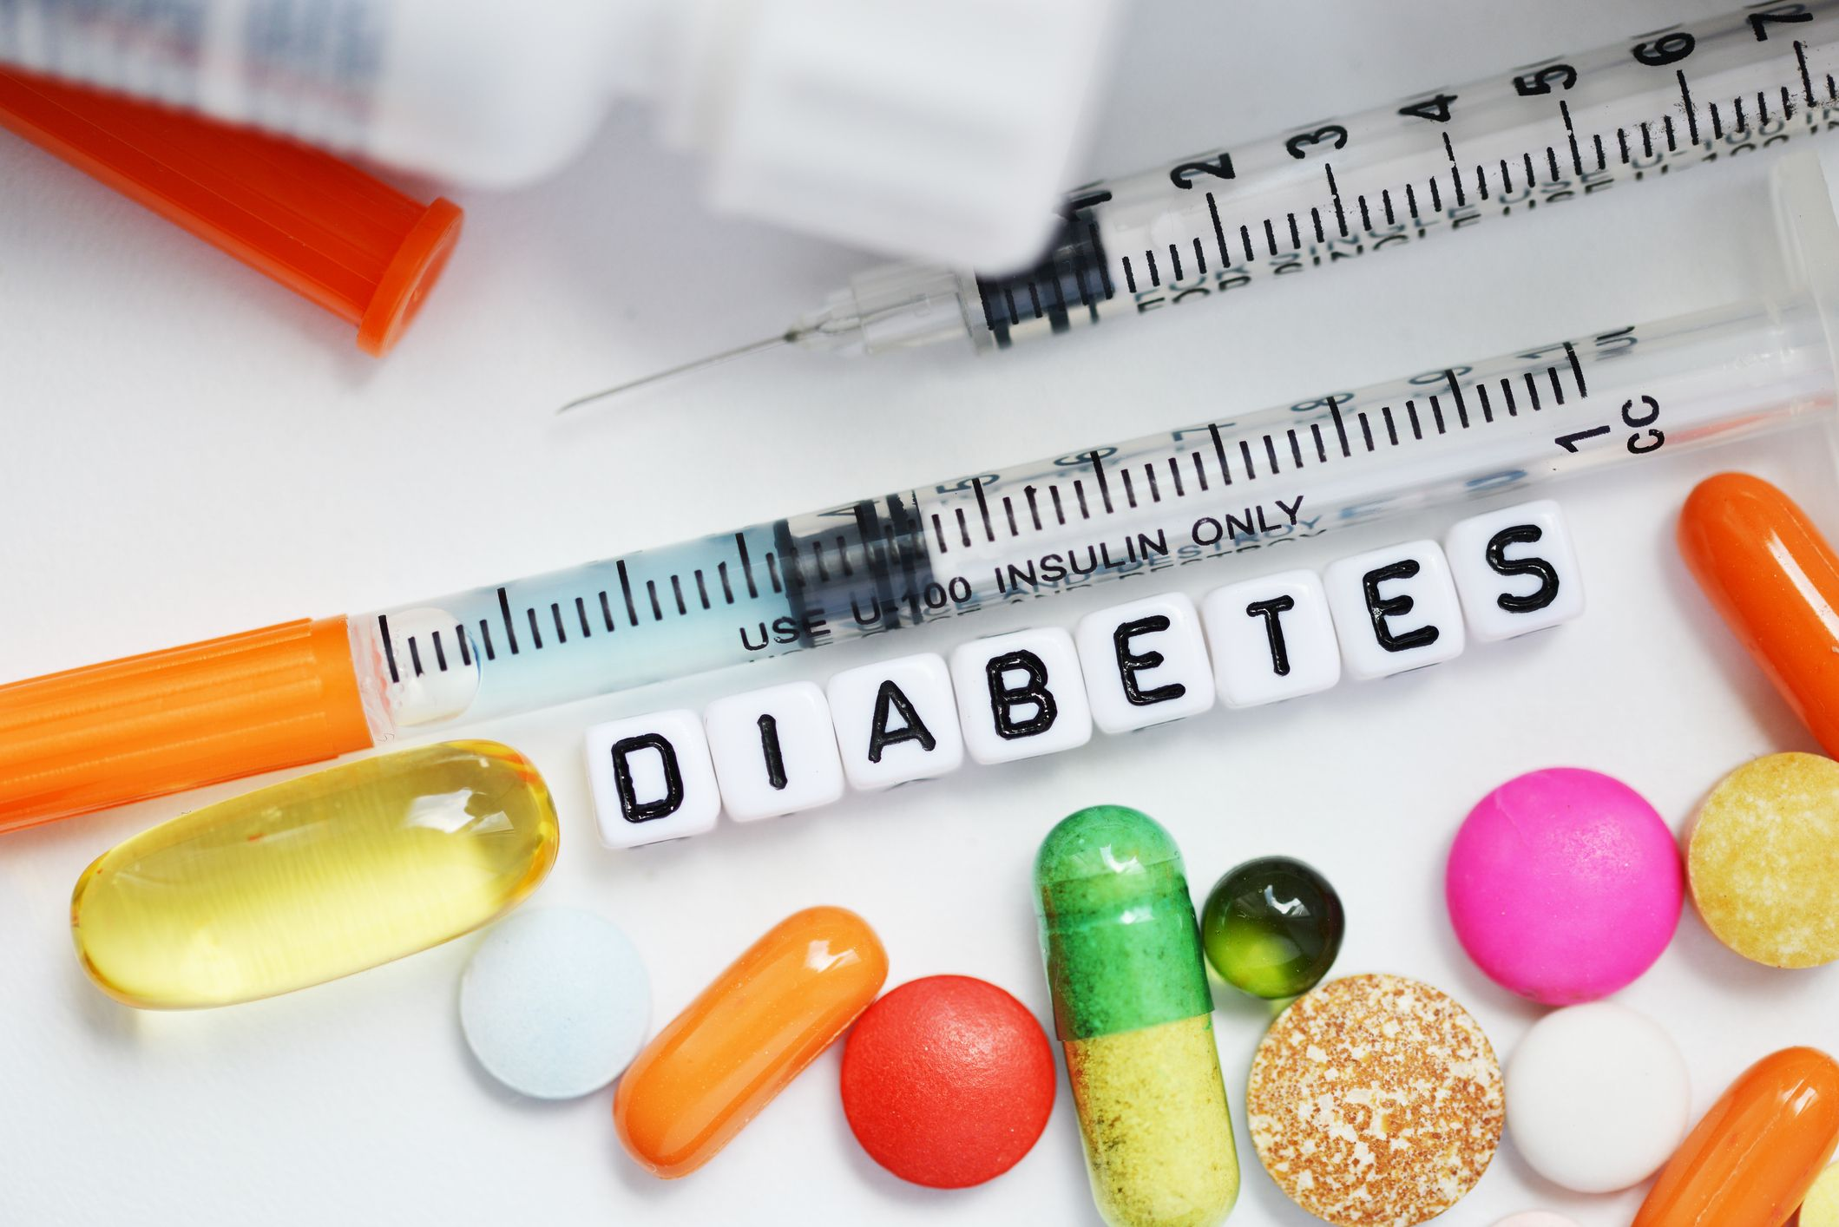



Slide 2
Outline
Executive Summary
Introduction
Methodology
Results
Conclusion
Appendix

Slide 3
Executive Summary
Our dataset comprises health-related information of individuals, focusing on factors that might contribute to diabetes development. Diabetes is a prevalent health concern globally, and understanding its underlying factors can aid in prevention and management. In this study, we aim to conduct a comprehensive analysis of the dataset, extract key insights, and develop predictive models to understand the relationships between various features and diabetes outcomes.
Summary of all methodologies
Data Collection and Preparation
Data Wrangling and Preprocessing
Exploratory Data Analysis using Python Libraries
Data Visualization using Microsoft Power BI (Interactive Dashboard)
Data Preprocessing
Modelling, Hyper parameter tuning and Ensemble Method
Summary of the results
EDA results
Interactive Power BI Dashboard in screenshot.
Predictive Analysis Results

Slide 4
Introduction
Project background and context :
Our dataset is from the National Institute of Diabetes and Digestive and Kidney Diseases. The goal of this assignment is to build a predictive model that can diagnostically predict whether a patient has diabetes or not based on certain diagnostic measurements. Our goal is to create a tool that can help identify whether a person is likely to have diabetes based on some health-related measurements.
Key Questions
General Diabetes Statistics:
What is the distribution of diabetes outcomes (1 or 0) in the dataset?
What is the overall prevalence of diabetes in the dataset?
Correlation and Relationships:
How do Glucose levels vary for diabetic and non-diabetic individuals?
Is there a correlation between BMI and diabetes outcome?
What is the relationship between Age and diabetes prevalence?
Impact of Pregnancy:
How does the number of pregnancies affect the likelihood of diabetes?
Is there a difference in Glucose levels for women with different numbers of pregnancies?
Blood Pressure and Skin Thickness:
How does Blood Pressure vary for diabetic and non-diabetic individuals?
Does Skin Thickness have a significant impact on diabetes outcome?
Insulin and BMI:
How are Insulin levels distributed among diabetic and non-diabetic patients?
Is there a noticeable difference in BMI for individuals with diabetes?
Genetic Factors:
Does the Diabetes Pedigree Function vary significantly for diabetic and non-diabetic individuals?
Are there specific age groups where diabetes tends to be more prevalent?

Slide 5

METHODOLOGY

Slide 6
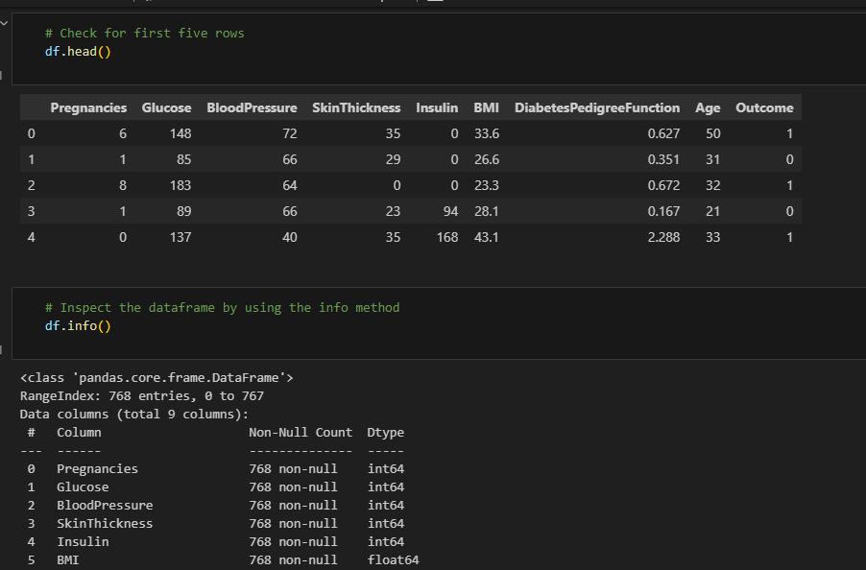
Data Collection and Preparation
We obtained a dataset containing information on pregnancies, glucose levels, blood pressure, skin thickness, insulin levels, BMI, diabetes pedigree function, age, and diabetes outcome.
After loading the data into the data set, I used various Python methods like head to get the first five rows, info to get a general overview of the data, including the dtypes and how many null values are present

Slide 7
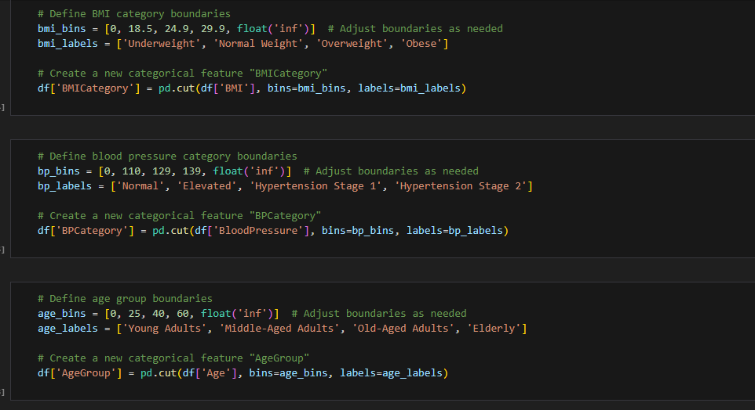
Data Wrangling and Preprocessing
The dataset was cleaned, addressing missing values and outliers to ensure the quality of the analysis.
I then performed feature engineering, including creating age groups, BMI categories, and blood pressure categories for a more structured approach to analysis.

Slide 8
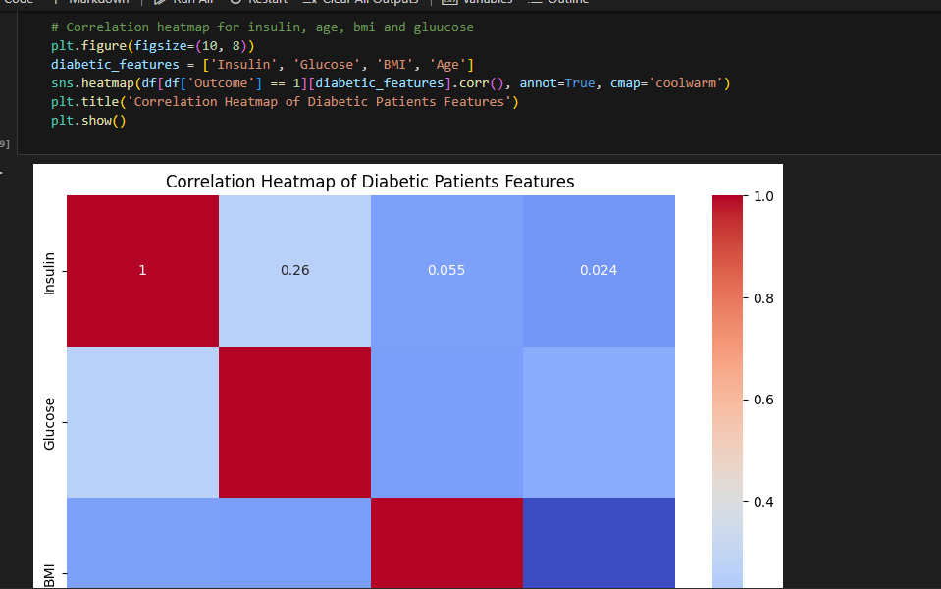
EDA with Python Libraries (Matplotlib and Seaborn)
To gain a deeper understanding of the data, I conducted EDA by visualizing and analyzing various features.
I formulated questions about diabetes and used EDA to answer them. Key insights included the influence of glucose levels, BMI, age groups and DPF on diabetes outcomes.

Slide 9
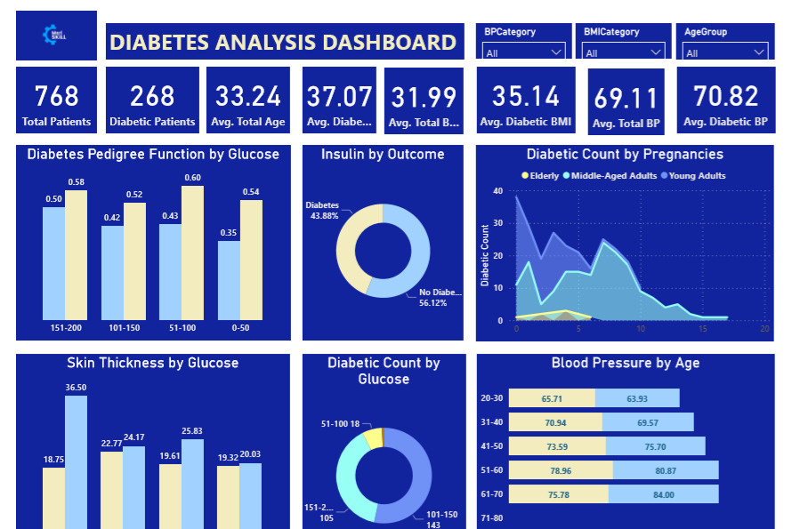
Data Visualization with Power BI
Power BI was used to create an interactive dashboard where key insights were found and effective recommendations were offered based on the dataset.

Slide 10

Data Preprocessing
We dropped useless columns, prepared the dataset for modeling by encoding categorical features (using label encoding for ordinal variables).
Scaling numerical features with standard scaler to make it suitable for modeling.
Splitting it into training and testing sets.

Slide 11
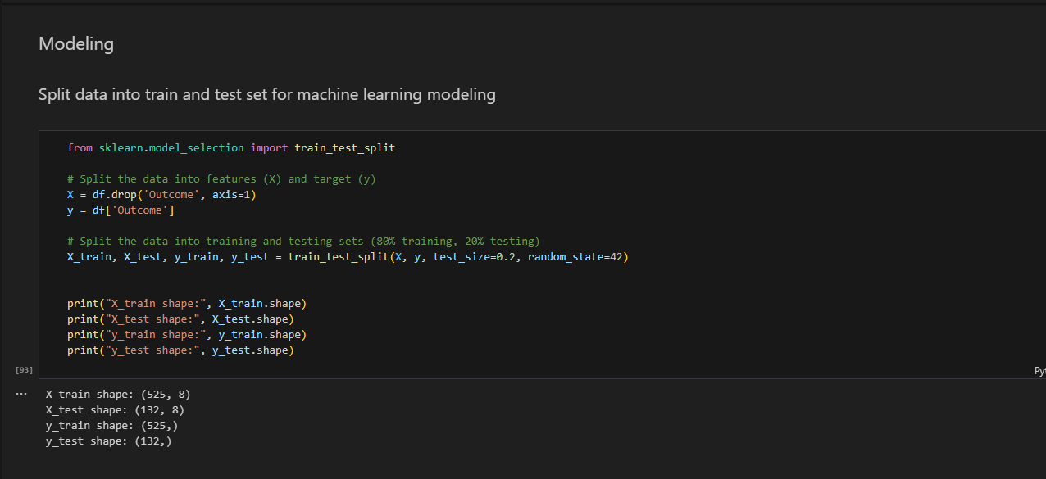
Modelling, Hyper-parameter tuning and Ensembling
I trained several machine learning models, including Logistic Regression, Random Forest, and XGBoost, to predict diabetes outcomes. I performed cross-validation to evaluate model performance. For certain models, I employed grid search to optimize hyper-parameters and improve model accuracy (and compare results to pick the best).
Then I realized that the model did not perform well because of imbalanced data. As a result, I implemented techniques such as resampling to address this issue.
I then combined the predictions from multiple models using an ensemble method to enhance predictive accuracy.
We assessed the models using various performance metrics, including accuracy, precision, recall, F1-score, confusion matrices, and classification reports.

Slide 12
Results
Exploratory Data Analysis results
Snapshots of interactive dashboard from PowerBI
Predictive analysis results

Slide 13

RESULTS

Slide 14
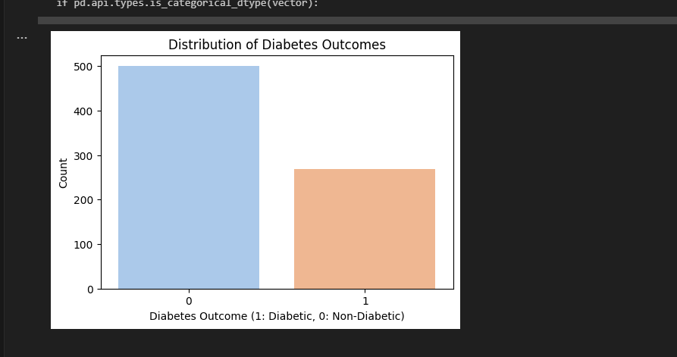
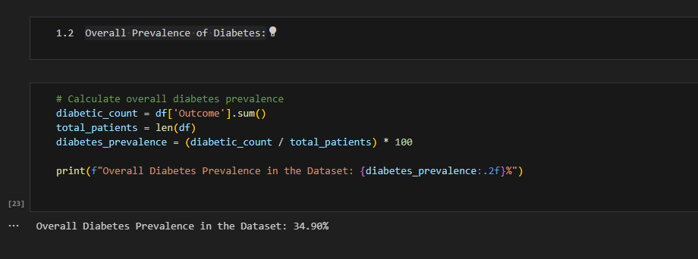
1. General Diabetic Statistic
What is the distribution of diabetes outcomes (1 or 0) in the dataset?
Overall Prevalence of Diabetes
1. The dataset consists of 768 observations.
2. Among these, there are 268 cases where the 'Outcome' variable is 1, indicating diabetes.
3. This means that approximately 34.90% of the individuals in the dataset are diagnosed with diabetes.

Slide 15
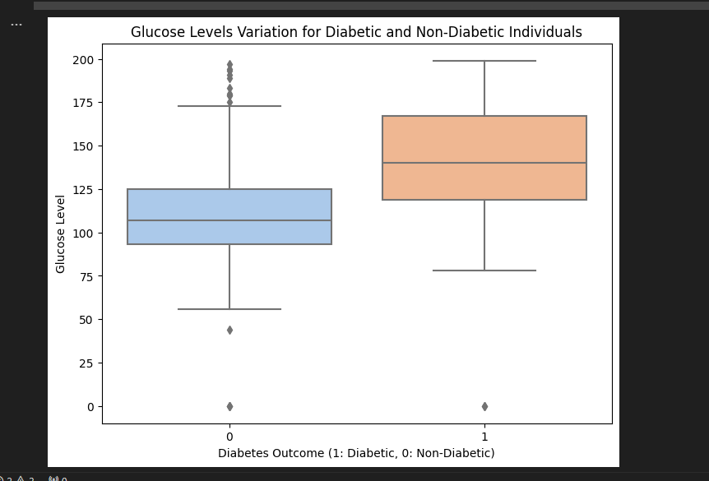
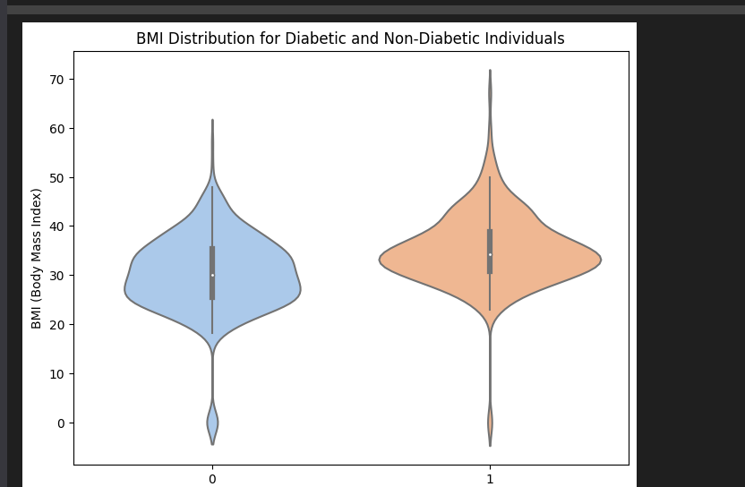
2. Correlation and Relationships
How do Glucose levels vary for diabetic and non-diabetic individuals?
Is there a correlation between BMI and diabetes outcome?

Slide 16
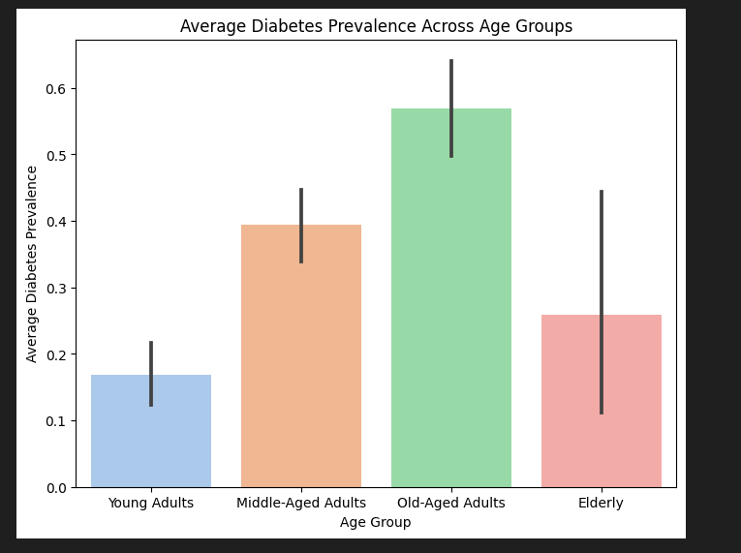
2. Correlation and Relationships
What is the relationship between Age and diabetes prevalence?
Insights
1. Glucose Levels and Diabetes Risk: The higher median Glucose level for diabetic patients (around 135) compared to non-diabetic patients (around 115) indicates that individuals with diabetes tend to have higher Glucose levels. This observation emphasizes the importance of monitoring Glucose levels, especially in individuals with a family history of diabetes or other risk factors. Regular monitoring and management of Glucose levels are crucial for diabetes prevention and control.
2. BMI and Diabetes Risk: Diabetic patients exhibit a higher median BMI (around 35) compared to non-diabetic patients (around 30). This suggests that higher BMI is associated with a higher risk of diabetes. It underscores the importance of monitoring and managing BMI levels, especially in individuals with a family history of diabetes or other risk factors. Lifestyle modifications, including diet and exercise, can play a significant role in managing BMI and reducing diabetes risk.
3. Age Group and Diabetes Prevalence: The higher diabetes prevalence among middle-aged individuals underscores the significance of age as a contributing factor. When combined with Glucose levels and BMI, age can provide a more nuanced understanding of diabetes risk. Middle-aged and old-aged adults, especially those with higher Glucose levels and BMI, might benefit from targeted interventions and regular health screenings.

Slide 17
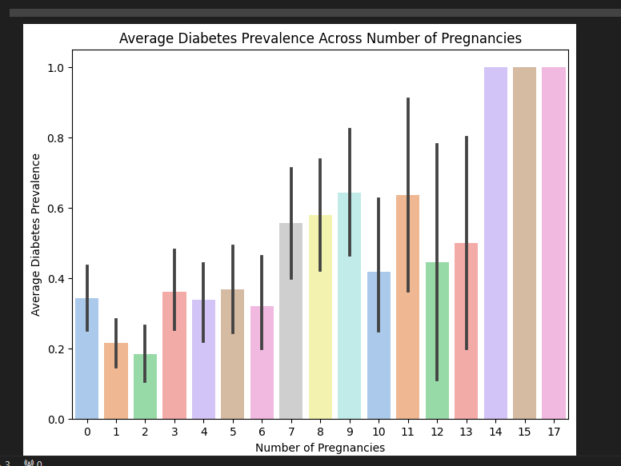
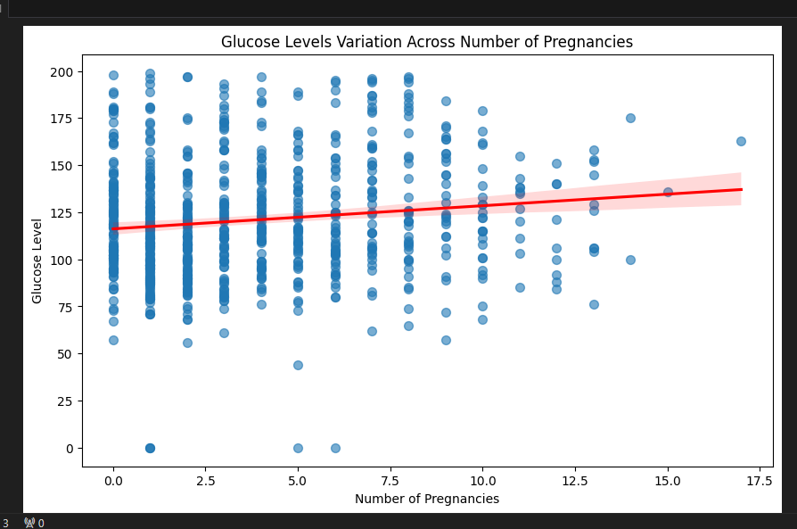
3. Impact of Pregnancy
How does the number of pregnancies affect the likelihood of diabetes?
Glucose level variations across numbers of pregnancies
1. Pregnancies and Diabetes Risk: On average, a higher number of pregnancies is associated with a higher risk of diabetes. This suggests that pregnancy history might be a significant factor contributing to diabetes risk. It's essential for healthcare providers to consider this factor when evaluating diabetes risk in women.
2. Relationship between Glucose Levels and Pregnancies: The scatter plot with a line of best fit indicates a very weak positive correlation between the number of pregnancies and Glucose levels. While there might be a subtle increase in Glucose levels with an increasing number of pregnancies, the effect is minimal and might not be practically significant.

Slide 18
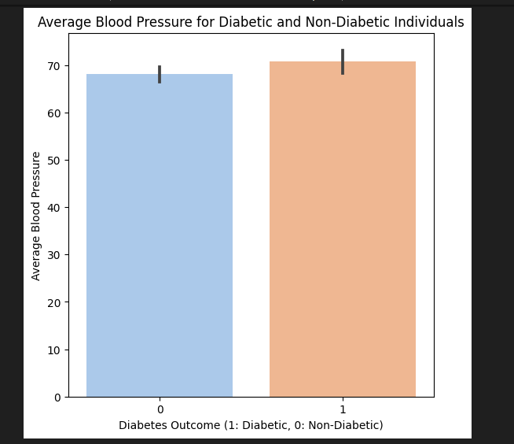
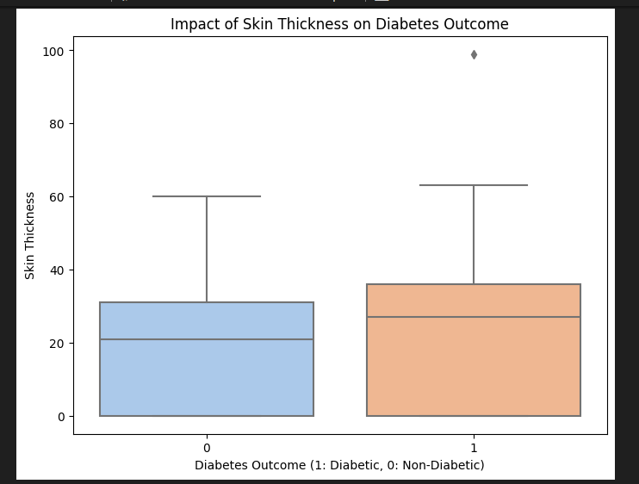
4. Blood Pressure and Skin Thickness
How does Blood Pressure vary for diabetic and non-diabetic individuals?
Impact of skin thickness on diabetic outcome
1. Average Blood Pressure (BP) Values: Non-diabetic individuals exhibit slightly lower average BP compared to diabetic individuals, indicating a subtle trend. While the difference is not significant, it suggests a potential influence on diabetes outcome.
2. Skin Thickness and Diabetes Outcome: Median Skin Thickness is notably lower for non-diabetic individuals (around 22) compared to diabetic individuals (around 27). This discrepancy hints at a correlation between lower Skin Thickness and diabetes, underscoring the importance of exploring this relationship further.

Slide 19
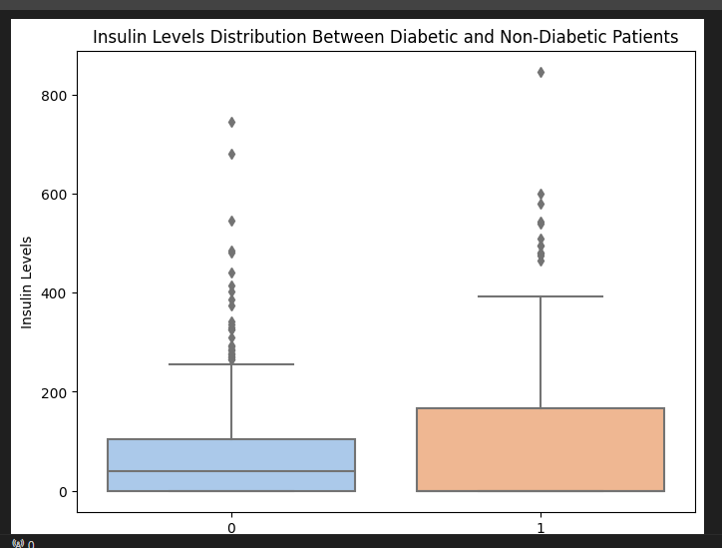
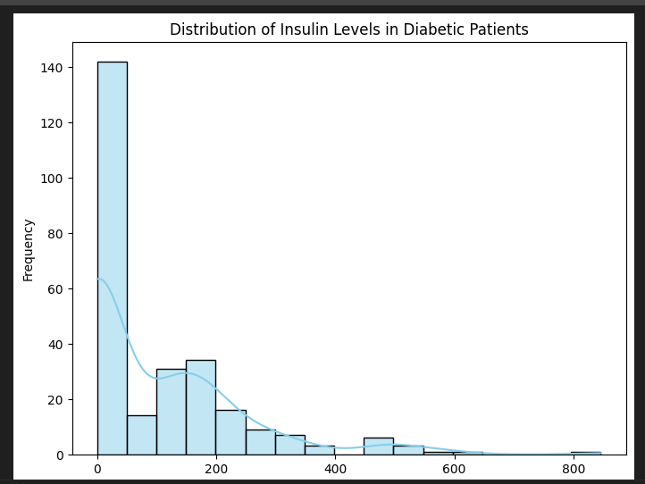
5. Insulin and BMI
How are Insulin levels distributed among diabetic and non-diabetic patients?
Distribution of Insulin Among Diabetic Patients

Slide 20
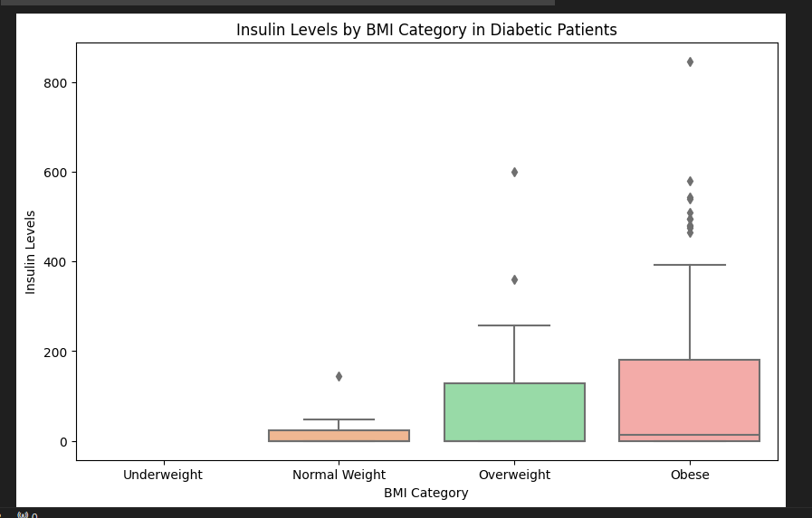
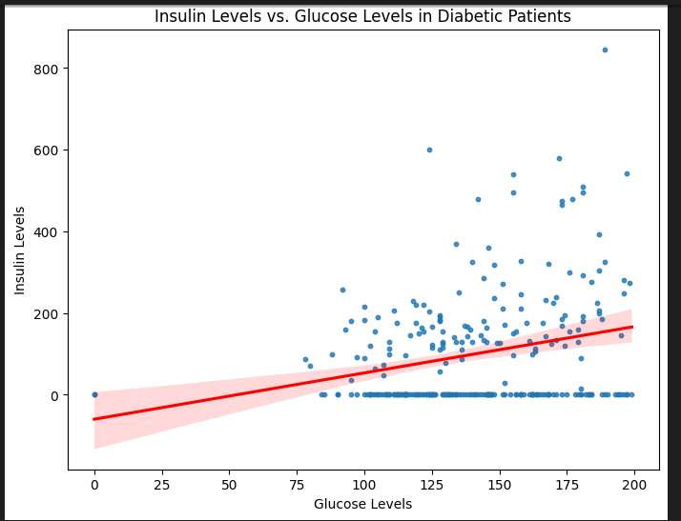
5. Insulin and BMI
Is there a noticeable difference in Insulin and BMI for individuals with diabetes?
Is there a visible correlation between Glucose and Insulin?
1. Insulin Levels Distribution: The box plot reveals the distribution of Insulin levels for both non-diabetic and diabetic patients. Among non-diabetic patients, Insulin levels appear concentrated below 50, indicating a distinct pattern within this range. Diabetic patients exhibit a wider spread of Insulin levels, emphasizing the variability within this group.
2. Insulin Levels by BMI Category: The box plot categorized by BMI shows higher variability in Insulin levels among diabetic patients in the "Obese" category. This variability suggests diverse factors influencing Insulin production within obese diabetic individuals. The absence of visible median lines for other BMI categories indicates potential outliers or skewed distributions in Insulin levels within those groups.

Slide 21
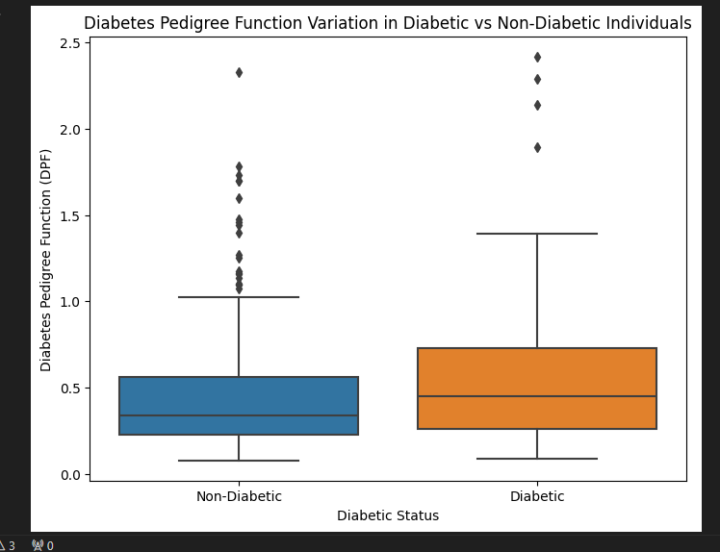
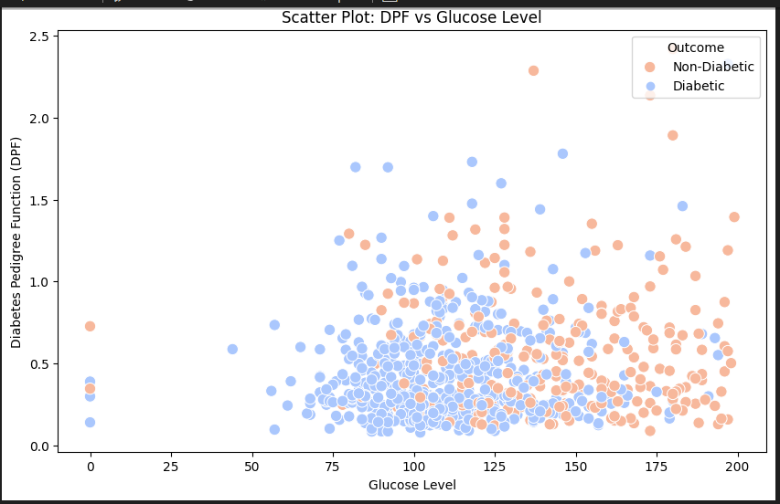
6. Genetic Factors
Does the Diabetes Pedigree Function vary significantly for diabetic and non-diabetic individuals?
Glucose vs DPF across Diabetic and Non Diabetic patients

Slide 22
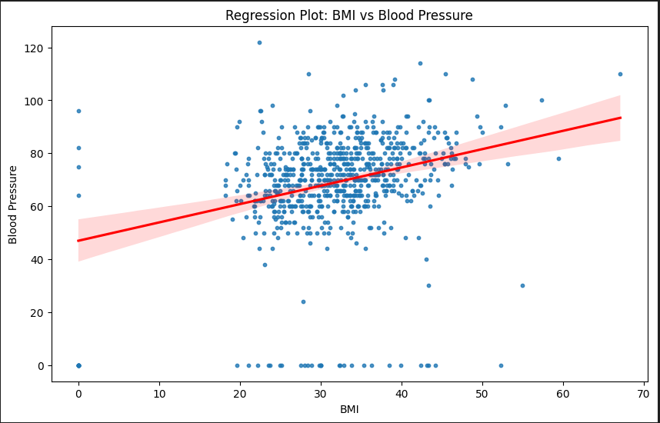
7. Other Factors
Relationship between BMI and BP
Observations.
Observations:
1. Diabetic Patients (Outcome = 1): Glucose levels among diabetic individuals are concentrated around the 100 mark, indicating a common range for diagnosis.
2. Non-Diabetic Patients (Outcome = 0): Glucose levels in non-diabetic patients show a broader spread, highlighting the natural variability among healthy individuals.
Insights:
1. Diagnostic Patterns: The clustering of Glucose levels around 100 suggests a potential diagnostic threshold for diabetes in the dataset.
2. Population Variability: Non-diabetic individuals display diverse Glucose levels, reflecting the natural differences in healthy individuals' Glucose readings.

Slide 23

DASHBOARD WITH POWER BI

Slide 24
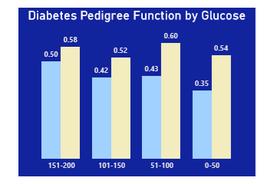
Diabetes Pedigree Function By Glucose
Glucose bin 51-100 has the highest frequency

Slide 25
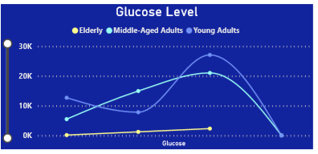
Glucose Level By Age By Diabetic Count
Young adults experience higher number of glucose

Slide 26
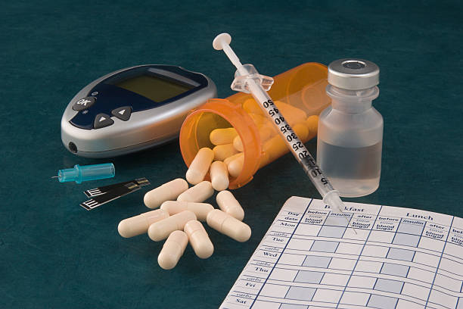
PREDICTIVE ANALYSIS

Slide 27
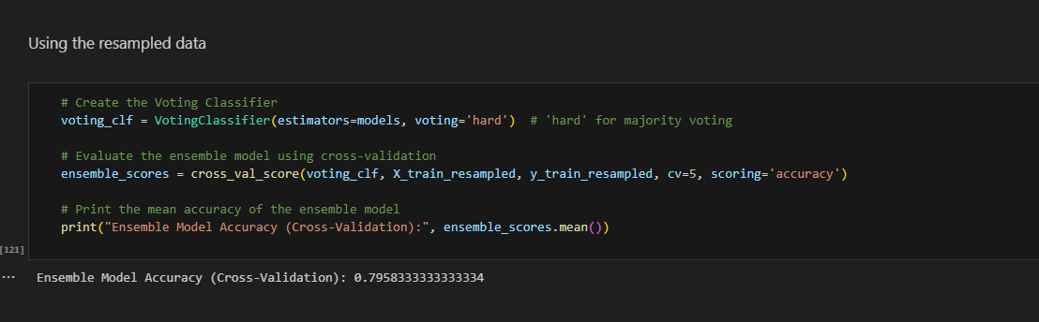
Classification Accuracy
The ensemble model achieved a cross-validation accuracy of 79.58%, demonstrating its effectiveness in predicting diabetes outcomes.

Slide 28
Conclusions
Glucose Levels Play a Pivotal Role: The analysis highlighted the significant impact of glucose levels on diabetes outcomes. Individuals with lower glucose levels, around 115, tend to have a higher risk of diabetes. This finding emphasizes the importance of regular glucose monitoring, especially for those hovering around this threshold.
BMI's Limited Predictive Power: Despite the common belief, BMI alone does not definitively predict diabetes risk. Diabetic patients displayed a higher median BMI, yet BMI varied widely in both diabetic and non-diabetic groups. This suggests that while weight management is essential, other factors such as genetics and lifestyle choices significantly influence diabetes outcomes.
Age-Specific Risks: Age emerged as a critical factor, with middle-aged and older individuals showing a higher diabetes prevalence. This insight underscores the need for targeted interventions and regular screenings, particularly in these age groups, to detect diabetes early and manage it effectively.
Genetic Factors and Diabetes Pedigree Function (DPF): The analysis revealed a nuanced relationship between genetics and diabetes outcomes. Diabetic patients exhibited a higher median DPF, suggesting a genetic predisposition. However, considering age groups, DPF varied, indicating complex interactions between genetics and lifestyle factors. Personalized healthcare plans based on genetic predisposition and lifestyle choices are crucial for effective diabetes management.

Slide 29
Appendix
Pregnancies: This feature represents the number of times a person has been pregnant. It's a count of pregnancies.
Glucose: Glucose is a type of sugar in the blood. This feature measures the concentration of glucose in the person's blood, which can be an indicator of diabetes risk.
Blood Pressure: Blood pressure is the force of blood pushing against the walls of the arteries. This feature measures a person's blood pressure, which is important for overall health.
Skin Thickness: This feature represents the thickness of the skinfold at a specific location on the body. It's a measure of body fat.
Insulin: Insulin is a hormone that helps regulate blood sugar. This feature measures the level of insulin in the blood.
BMI (Body Mass Index): BMI is a way to measure if a person has a healthy weight for their height. It's calculated from a person's weight and height.
Diabetes Pedigree Function: This feature is a calculation that indicates a person's genetic predisposition to diabetes. It considers family history.
Age: This is the person's age in years.
Outcome (Target Variable): This is what we want to predict. It's a binary variable, where:
0 means the person does not have diabetes.
1 means the person has diabetes.

Slide 30

THANK YOU

